Slide 1
Platform Stabilization using PID Controller
Ashwin S - CB.EN.U4ECE23106
Kaushal Soundararajan - CB.EN.U4ECE23125
Nidhil Remila Shivakumaran - CB.EN.U4ECE23129

Slide 2
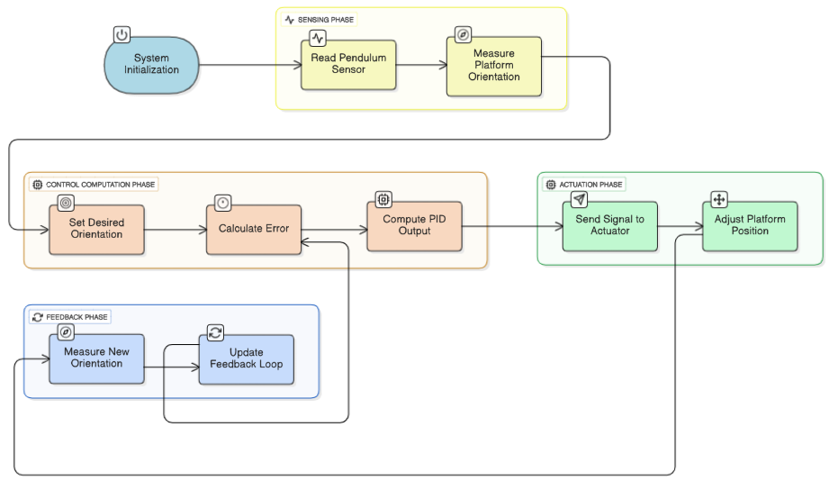
Block Diagram

Slide 3
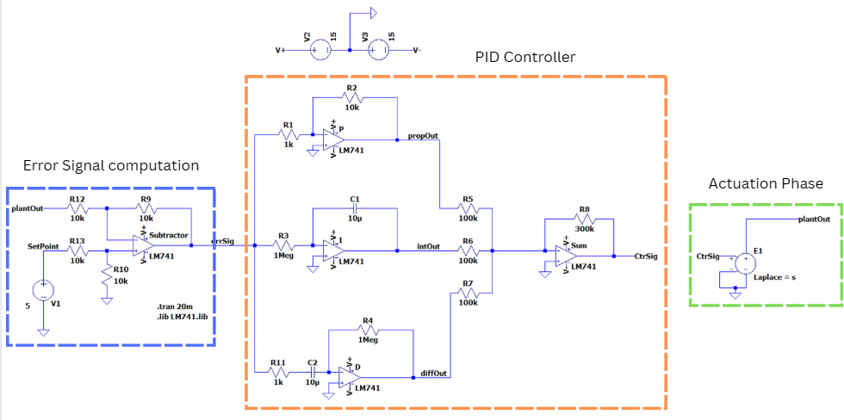
Circuit Diagram

Slide 4
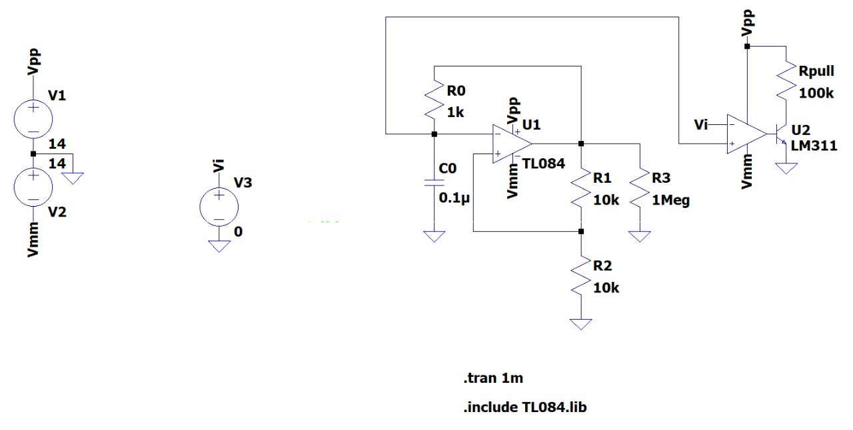
Circuit Diagram
Motor Driver:
  An astable multivibrator is used in connection with a comparator to generate a PWM signal.
  The PWM output is then connected to a L293D Motor Driver IC which will control the DC motor.
Comparator
Astable Multivibrator

Slide 5
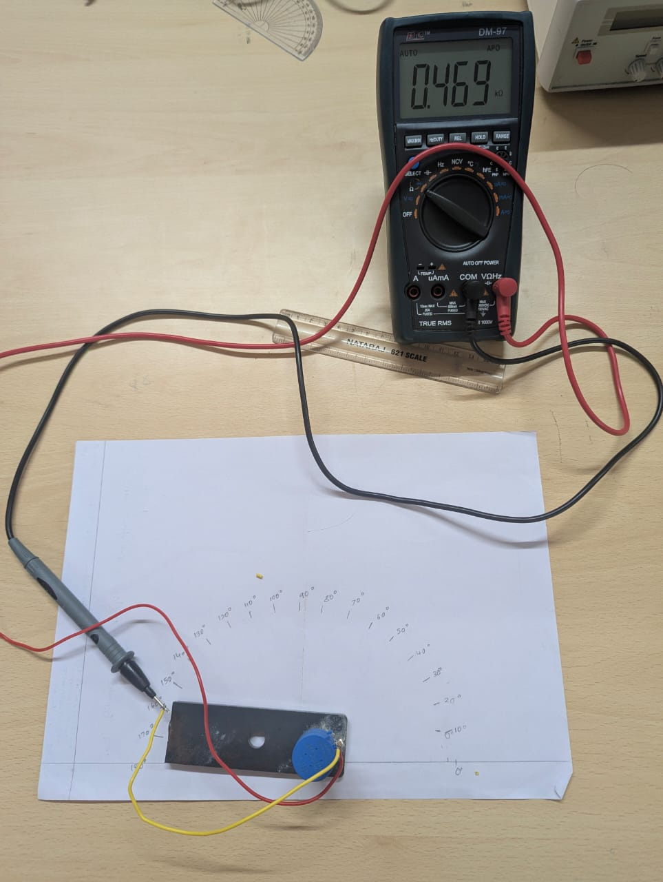
Sensor Calibration
  The Sensor consists of a potentiometer connected to a weight at its shaft.
  The calibration is done by keeping the potentiometer at a fixed position and moving the weight connected to it by 10 degrees.
  The resistance shown by the potentiometer at each 10 degree intervals is recorded using a multimeter.
  The paper below is marked at 10 degree intervals to rotate the weight.

Slide 6
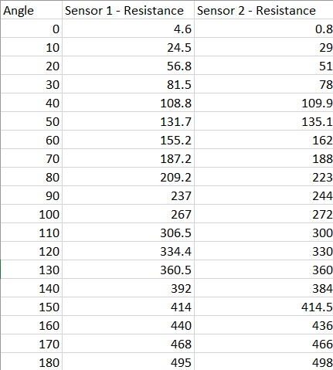
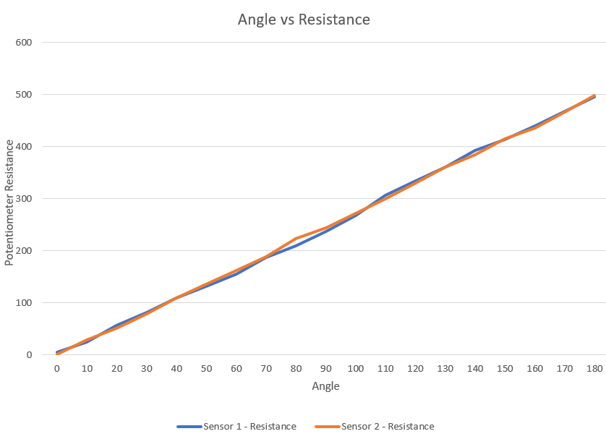
Sensor Calibration
Two sensors are used for dual-axis stabilization

Slide 7
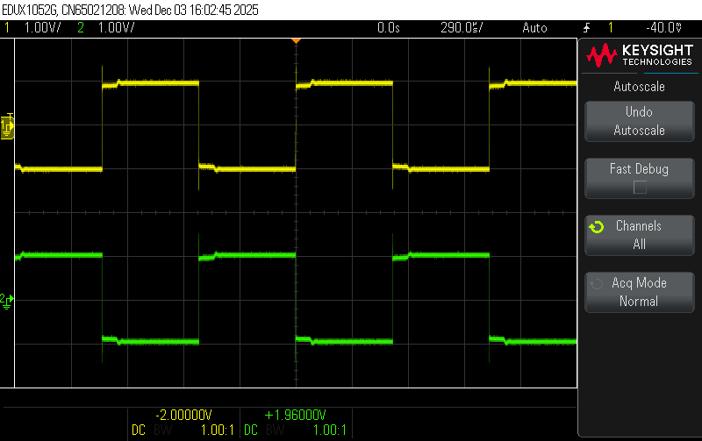
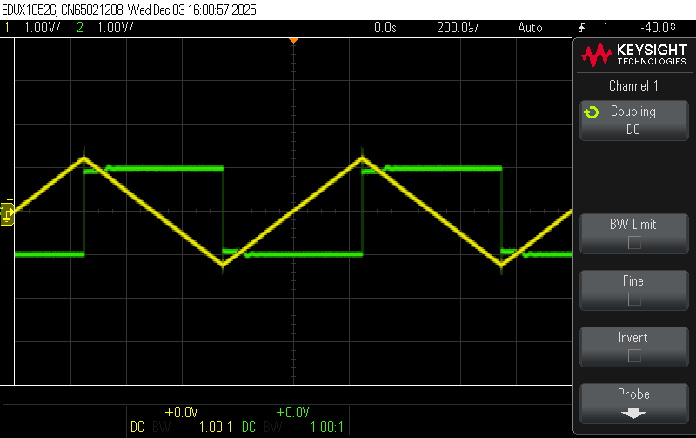
Outputs
Proportional:
Integrator:

Slide 8
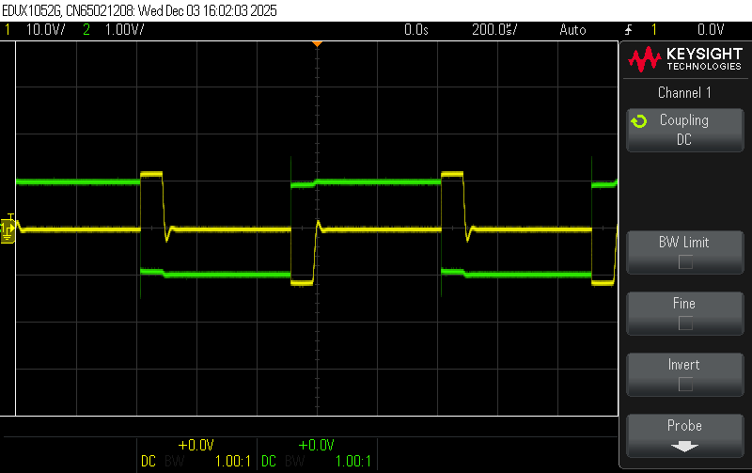
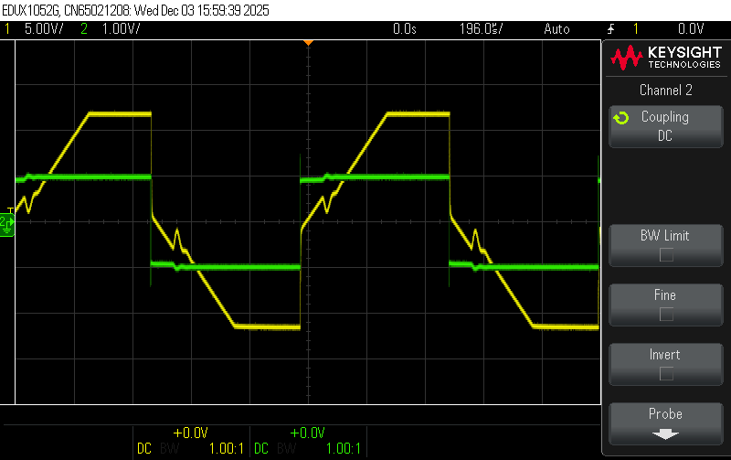
Outputs
Differentiator:
PID:

Slide 9
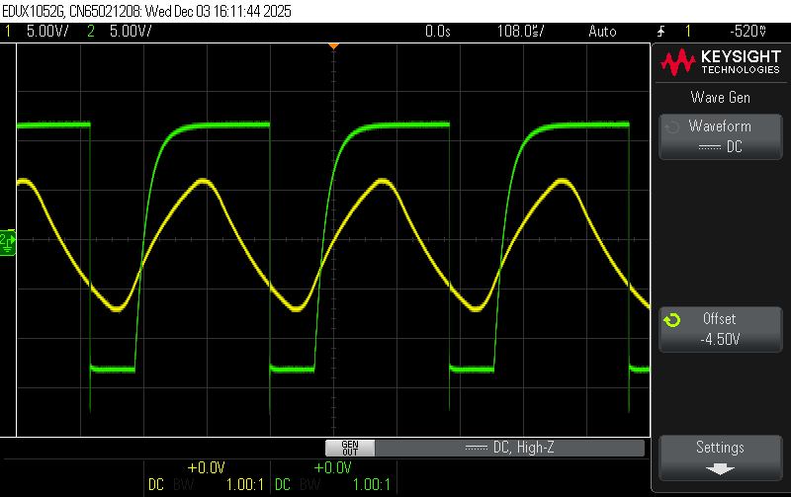
Outputs
PWM:

Slide 10
Components
S.No | Component | Quantity | Specification | Lab/Store
1. | TL084 (Quad Op-amp) | 5 |  | Lab
2. | LM311(Comparator) | 1 |  | Lab
3. | Resistors | 5, 2, 10, 2, 3, 1 | 1k, 1.5k, 10k, 51k, 100k, 510k | Lab
4. | Capacitors | 2, 1, 1, 1 | 0.1μF, 0.33μF, 0.47μF, 1μF | Lab
5. | Potentiometer | 3 | 47k | Lab
6. | CA3046 (NPN Transistor Array) | 2 | β=100, VBE=0.6V | Lab

Slide 11
Components
S.No | Component | Quantity | Specification | Lab/ Store(Price)
7. | L239D (Motor Driver IC) | 2 |  | Lab
8. | Connecting Wires | As Required |  | Lab
9. | Breadboard | 2 |  | Lab
10. | Bourns 3590S Potentiometer | 2 | 10k, 10-Fold Potentiometer | Store (145/piece)
11. | DC Motor | 2 | 12V, Torque 12 Kg.cm | Store (180/piece)

Slide 12
The End

